Slide 1
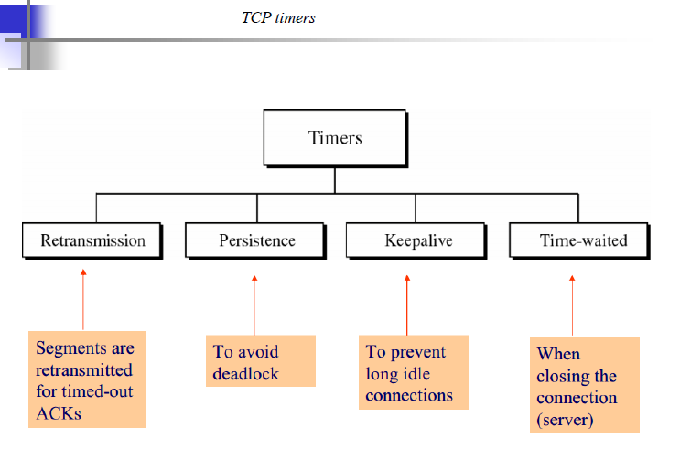

Slide 2
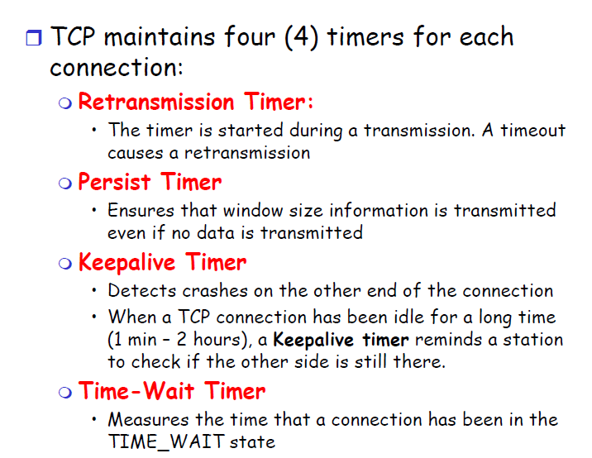

Slide 3
Retransmission Timer
To retransmit lost segments, TCP employs one retransmission timer , that handles the retransmission time-out (RTO).
We can define the following rules for the retransmission timer:
When TCP sends the segment in front of the sending queue, it starts the timer.
When the timer expires, TCP resends the first segment in front of the queue, and restarts the timer.
When a segment are cumulatively acknowledged, the segment are purged from the queue.
If the queue is empty, TCP stops the timer; otherwise, TCP restarts the timer.

Slide 4
Round-Trip Time (RTT)
To calculate the retransmission time-out (RTO), we first need to calculate the roundtrip time (RTT).
Measured RTT The measured round-trip time for a segment is the time required for the segment to reach the destination and be acknowledged, although the acknowledgment may include other segments.
We use the notation RTTM to stand for measured RTT.

Slide 5
Round-Trip Time (RTT)
Smoothed RTT The RTTM, is likely to change for each round trip.
The fluctuation is so high that a single measurement alone cannot be used for retransmission time-out purposes.
Most implementations use a smoothed RTT, called RTTS, which is a weighted average of RTTM and the previous RTTS as shown below.

Slide 6

Round-Trip Time (RTT)
The value of α is implementation-dependent, but it is normally set to 1/8. In other words, the new RTTS is calculated as 7/8 of the old RTTS and 1/8 of the current RTTM.

Slide 7

Round-Trip Time (RTT)
RTT Deviation Most implementations do not just use RTTS; they also calculate the RTT deviation, called RTTD, based on the RTTS and RTTM using the following formulas.
The value of β is also implementation-dependent, but is usually is set to ¼.

Slide 8

Retransmission Time-out (RTO)
The value of RTO is based on the smoothed round-trip time and its deviation. Most implementations use the following formula to calculate the RTO:
D

Slide 9
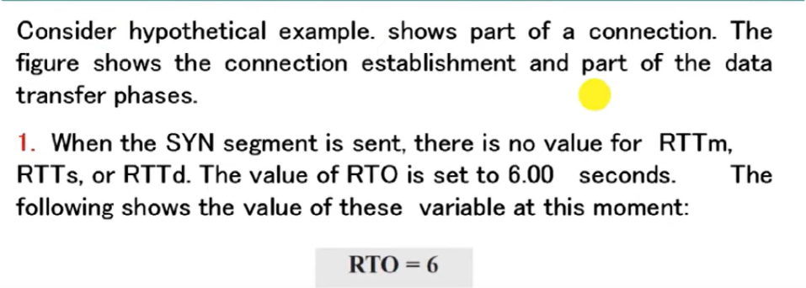
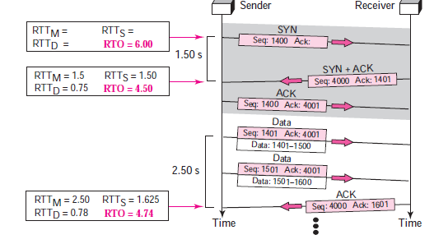
Example

Slide 10
Karn’s Algorithm
Suppose that a segment is not ack and is therefore retransmitted.
When the sending TCP receives an acknowledgment for this segment, it does not know if the ack is for the original segment or for the retransmitted one.
Do not consider the round-trip time of a retransmitted segment in the calculation of RTTs.
Do not update the value of RTTs until you send a segment and receive an acknowledgment without the need for retransmission

Slide 11
Exponential Backoff
What is the value of RTO if a retransmission occurs?
The value of RTO is doubled for each retransmission.
If the segment is retransmitted once, the value is two times the RTO.
If it transmitted twice, the value is four times the RTO, and so on.

Slide 12
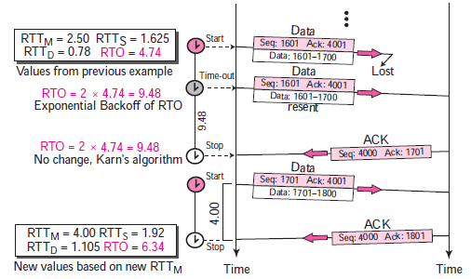
Example

